Slide 1
CTF model for long reverberation Date：2022. 07. 12
Telecom Electroacoustics Audio(TEA) Lab
Presenter:
Anchi Yuan
Notes:
Hello everyone
I’m today’s presenter siang. I’m going to share some of my present work in source separation problem. My topic is comparative studies of source separation using semi-blind and blind source separation approaches.

Slide 2
Outline
Reconstruct RIR from CTF using impulse signal
Simulation setting
Reconstruction result
Modified method for ATF prediction

Slide 3
Reconstruct RIR from CTF using impulse signal

Slide 4
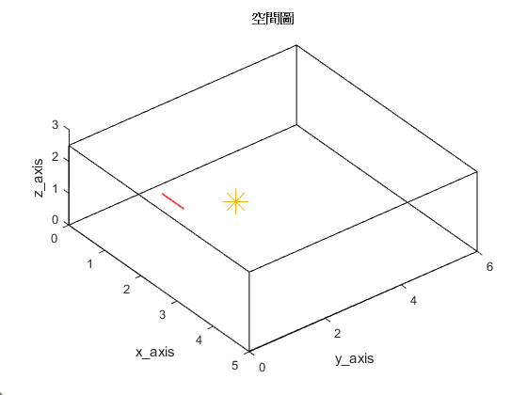

Simulation setting
Uniform linear array (ULA)
Number of microphones = 30
Spacing = 0.02m (2cm)
Aperture = (30-1)*0.02 = 0.58 m
Room size = 5m $×$6m $×$2.5m
Sampling frequency = 16kHz
Reverberation time T₆₀ = 0.2s 0.4s
First microphone location [1, 1.5, 1]
2.5m
origin
Source location [2, 2.6, 1]
5m
6m

Slide 5
Reconstruction result(1)
Direct ISTFT
ISTFT with impulse signal
T₆₀ = 0.2s

Slide 6
Reconstruction result(2)
Direct ISTFT
ISTFT with impulse signal
T₆₀ = 0.4s

Slide 7
Modified method for ATF prediction
expect that lasso can increase sparsity of prediction source

Slide 8


